Slide 1
Online Exam Portal
PRESENTED By –
Omkar Jadhav – 240343120049
Omkar Khadke – 240343120050
Priya Wagh – 240343120064
Shruti Narkhede – 240343120081

Slide 2
ABSTRACT
Online Exam Portal is a digital platform used to conduct exams over the internet. It provides secure access, allows easy exam creation and management, offers automated grading, and generates comprehensive reports.
This technology enhances efficiency, scalability, and exam integrity, making it a valuable tool for educational institutions and organizations managing certification programs.
It will used for students progress evaluation using modern computer technology. It replaced the paperwork and overcome the outcomes of traditional way of examinations using paper or pen. This helps students of schools/ College/ Institutes is to offer a quick and easy way to appear for the exam.

Slide 3
Objectives
To provide an interface through which student can appear for examination online for objective as well as subjective type questions.
To provide registration for students done by themselves.
The Online Examination System inspects the candidate appearing for the exam through the online objective test.
The answer/response chosen by the candidate will be verified by an automated mechanism.
It is an integrated Online Examination System that minimizes the paperwork for both the examiners and examinees.
It allows the examiners to create/prepare the question paper.

Slide 4
Scope
Online Examination System is widely used as compared to other examination method these days.
Online examination system can be used by corporate organizations and educational institution as well.
As it is convenient and adaptable, web-based application can be used anywhere and anytime.
As every coin has two faces, the same goes with the software every software may have some instances of bugs, errors, security related problems or system faults.
There may be occurrence of different problems or system faults for example, computer collapse or crashes due to power supply problem will invalidate efforts of number of students

Slide 5
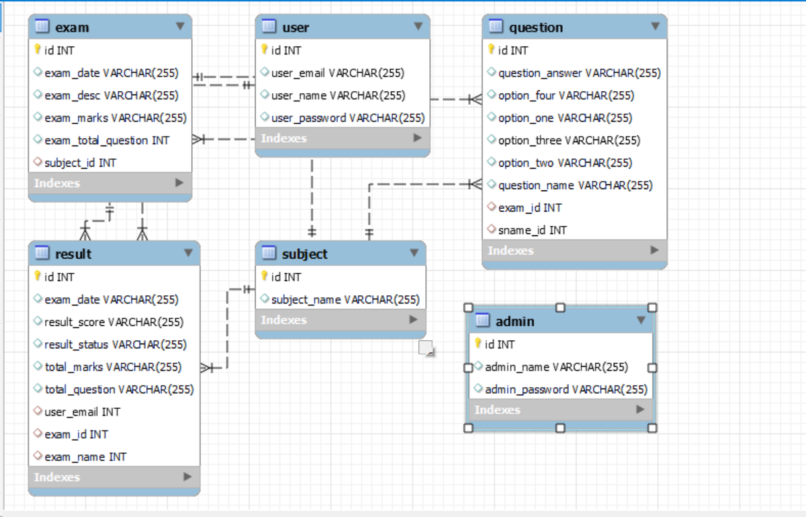
ER Diagram

Slide 6
Module Description
This section includes the modules, architecture and various elements that are combined to form the whole system's framework.
Registration Module: It will allow new user to get register on the website. User needs to provide his/her full name, email id, contact number, & password while registering.
Login Module: In this module user can login to the website by entering login ID and password. After Login the system links to Profile page.

Slide 7
Quiz Module: It allows the admins to add, update, or delete quiz. Fach quiz belongs to one category. This allows to filter the quiz by category. Normal user (students) can see the quizzes and if they desire, they can attempt the quiz.
Exam Module: This is the main module which handles the logic used when a student starts the quiz. Timer will run for each quiz, & once it finishes, quiz will auto-submit. The quiz can also be submitted by the student beforehand, by clicking on the Submit button. The exam module will pass the data entered by student to result module.
Result Module: This module produces the result for each attempted quiz. The attempted question by students is matched against the correct answer saved in database. And based on that the result is generated

Slide 8
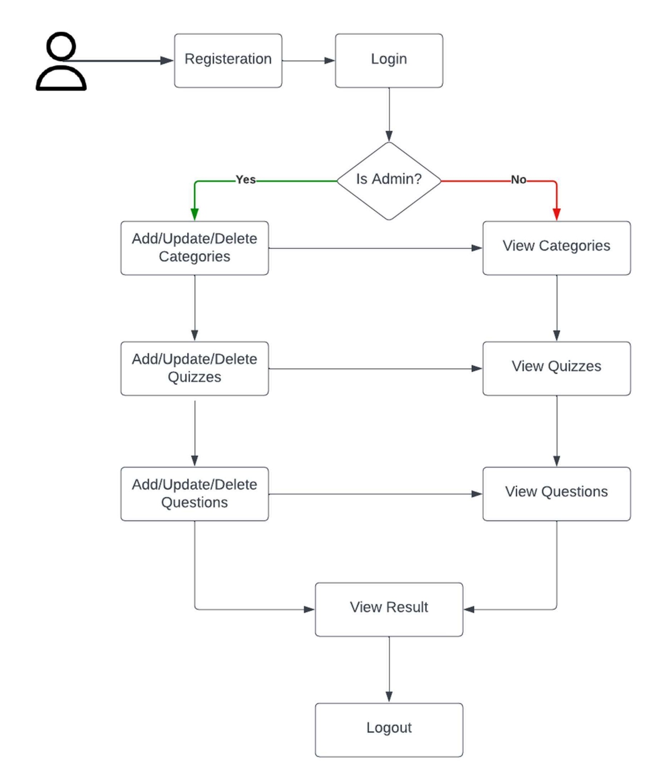
Flow Chart

Slide 9
Future Scope
Steady improvement in innovation has prompted a fast development of the evaluation business. Large numbers of the training organizations and colleges are building up their interest in web tests through online assessment programming for their understudies rather than pen and paper- based test. It demonstrates that online assessment software is the future of evaluation techniques. We have made an online assessment framework, and we will be dealing with it in the future and will make a great deal of improvement like
Adding the screen-sharing & live camera feature to enhance the security and prevent any kind of suspicious activities.
Voice acknowledgment.
Fingerprint validation,
Facial recognition acknowledgment.

Slide 10
Conclusion
This paper introduces a secure system for internet-based exam invigilation, whose work maintains academic integrity in e-learning.
This web-based system is convenient and user- friendly for utilizing, from the candidate's perspective, as it only needs one laptop or smartphone.
The key concept is to minimize the amount of traditional, pen-paper form of examination and convert all forms of documentation to digital form.
It was observed that the data/information required can be obtained with much simplicity, accuracy and in a secure manner, through the computerized system.
The user with limited knowledge about the computer may also access the system with ease.

Slide 11
THANK YOU !!!

